Slide 1
Living the dream
Real world DevOps with Azure and VSTS

Slide 2
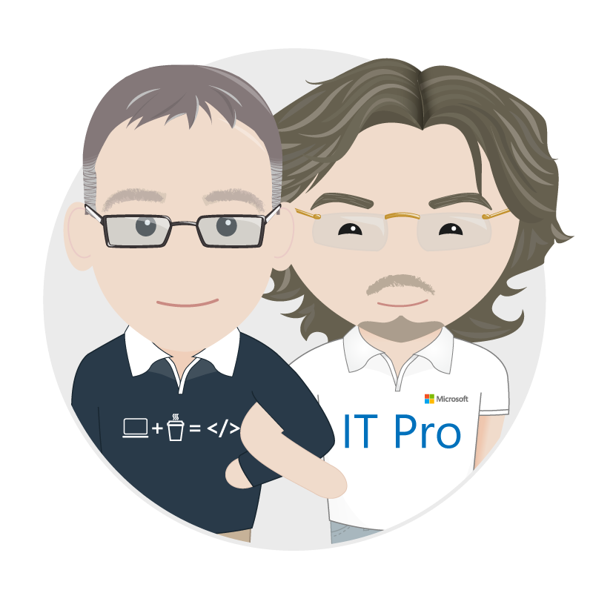



Richard Fennell
Engineering Director, Black Marble
MVP (Visual Studio and Developer Tools)
ALM Ranger
Rik Hepworth
IT Director, Black Marble
MVP (Azure)
@rikhepworth
@richardfennell
blogs.blackmarble.co.uk

Slide 3

What is DevOps
“Development and Operations collaboration”
“Automation”
“Faster and smaller releases”
“A job title”
Notes:
So, what is DevOps exactly?
DevOps is a term for a group of concepts that, while not all new, have catalyzed into a movement and are rapidly spreading throughout the technical community.
Like any new and popular term, people have different and sometimes contradictory perceptions of what it is.
One thing is sure: it’s not a product that you buy and install to fix everything that is wrong or broken with software development.
However, tooling is an integral part of any DevOps discussion because tools help you execute on your DevOps strategy.
Today we’ll talk about how the application lifecycle is changing as it extends into IT operations and will take a closer look at our next wave of ALM and DevOps investments.

Slide 4




Walking through the process
Develop
Build
Deploy to QA
Deploy to Lab

Slide 5

Demo

Slide 6
DevOps Key Points
DevOps is a process not a technology solution
Your steps may differ
No one tool will solve everything
Configuration as code is a key enabler for automation
Essential for cloud; useful for on-prem

Slide 7
Useful Links
Black Marble custom VSTS Extensions: http://bit.ly/VSTSBM
Our Githubs: https://github.com/rikhepworth/ https://github.com/rfennell
Our blogs: http://blogs.blackmarble.co.uk

Slide 8

We’re using TFS on-premises.
How do I move to the cloud?

Slide 9
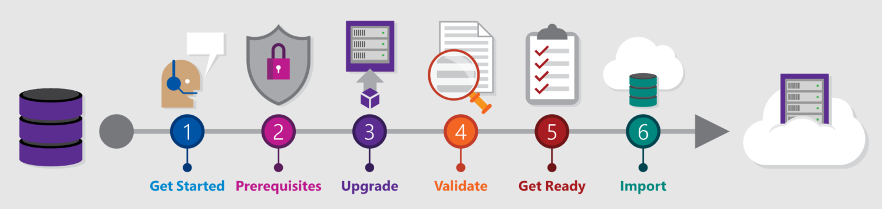
VSTS Migration Service

Slide 10
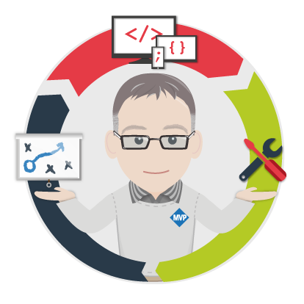
Black Marble DevOps Package Offering
An initial four day fixed package containing
Scoping workshop to identify suitable POC projects
Implementation of a VSTS/ARM based sample solution
Report including recommended roadmap
Followed by a packaged phase of work for POC or production projects

Slide 11
Black Marble DevOps Package Offering
Suggested follow-on package sizes
Size | Planning | POC | Delivery
S | 4 | 8 | 20
M | 4 | 10 | 30
L | 10 | 25 | 65
XL | 20 | 35 | 120

Slide 12
Black Marble VSTS Migration Offering
A Microsoft Gold DevOps Partner-Led offering
Assess TFS with migration tools
Perform a dry run migration to the cloud
Perform live migration to VSTS
This is a service that may qualify for Microsoft funding.
Talk to us for more details

Slide 14

“It was taking up to 12 days to develop a line of code – that didn’t feel appropriate to the speed at which we wanted to deliver features to our customers.
Thanks to the work we’ve undertaken with Black Marble and Microsoft this process is now down to a matter of hours.”
- Chief Product Architect

Slide 15
Three Objectives
Automated environment creation
Change attitude to environments
Rapid deployment of new environments

Slide 16
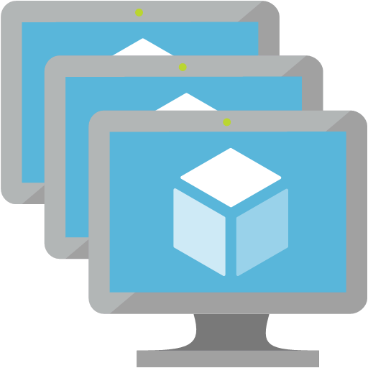


The Technologies
Visual Studio Team Services
Azure IaaS
Azure Resource
Templates
Azure DevTest Labs
Work tracking
Source repository
Automated build
Automated release
Multi-server environments for dev and test
Windows and Linux
Configuration as code declaration of environments
Managed wrapper for dev team environments

Slide 17
Early project wins
Kick-started cultural change in development
Demonstrated that up to 60% of time spent on activities such as regression testing will no longer be needed
Increased the SLA that can be offered to customers
Demonstrated a way to rapidly develop & release individual customer requests
Architected a way to reduce Code to Customer times from weeks to hours
Reduced projected cost of service in dev time, and hosting costs
Removed server downtime
Provided a safe way to try new ideas at minimal cost
Enabled dev streams to be re-launched

Slide 18
Benefits for end customers
Cost savings through increased service availability
Feature releases in hours, not weeks
Shortened service request cycles
‘Single Pane of Glass’ web-based services where customer & engineer can work hand-in-hand
Closer relationship through more regular interaction
Faster, smaller updates vs bulky major releases
Increased opportunity for innovation as ideas can be rapidly put into play in test environments

Slide 19
“It’s a mindset and organisational change – we had been fairly ‘traditional’ when it came to IT services so we didn’t take lightly the decision to introduce DevOps, but we knew in Black Marble we had absolutely the right partner for the job. The fact they’d been referred to us by their peers said a lot to use about the quality of what they could deliver.”
- Chief Product Architect

